Slide 1
SIT374/764: Project Management
Lecture 4: Time management (part 1)

Slide 2
Project management process groups
Approved Project Management Plan
Completion Report
Monitoring
Initiation
Planning
Executing
Closing
Control
Approved Project Charter
Customer signoff

Slide 3
Project management process groups-Activity Map
Project Plan
Acquire & manage
team
Monitor &
Control Proj.
Project
Closing
Project Charter
Scope
Time
Cost
Quality
HR
Risk
Procurement
Stakeholders
Comm.
Stakeholders
Register
Scope control &
verification
Select Sellers &
POs
Contract
Closing
Schedule control
Progress Reporting
Perform QA
Manage Stakeholders
Comm.
Contract Admin
Initiation
Planning
Executing
Mon. & Con.
Closing

Slide 4
How important is “time”?
Time has the least flexibility
Passes no matter what happens to the project
Delivering project on time is difficult
What affects time?
Individual characteristics
Cultural differences
Scope changes in project

Slide 5
Activity 1
You are an IT project manager overseeing the development of a new project management software. The software is intended to help organizations track their projects, allocate resources efficiently, and enhance team collaboration. The project was initially estimated to take 6 months to complete, with a team of 10 developers, two designers, and three testers.
Three months into the project, you realize that the project is significantly behind schedule. Upon reviewing the project's progress, you discover several time management issues:
Frequent Overruns: You notice that development tasks consistently take longer than estimated. Despite the developers' expertise, the time allocated for each task has been underestimated.
Multitasking: Team members are often pulled between multiple tasks, causing a loss of focus and productivity. The context switching has led to delays and errors, which further consume time for corrections and rework.
Scope Creep: The project scope has gradually expanded. New features and functionalities were added without proper review or adjustment to the project timeline. This scope creep has added more work than originally planned.
Communication Gaps: There seems to be a lack of clear communication among team members, leading to confusion about task priorities and deadlines. This has resulted in some critical tasks being delayed or overlooked.

Slide 6
Activity 1 (cont’d)
Given this situation:
a. Analyze how each identified issue contributes to the project's time management problems.
b. Propose specific strategies or practices that could be implemented to address each of these time management issues.

Slide 7
Processes in Time Management
Define Activities
Sequence
Activities
Resourcing/Estimate Activities Durations
Develop Schedule
Control
the Schedule
Plan schedule management
Monitoring and
Controlling
Planning

Slide 8
1. Plan schedule management
Plan schedule management is the process of establishing policies, procedures, and documentation for planning, developing and controlling the project schedule.
Key inputs include the project charter, scope management plan, development approach, and organizational process assets.
The main output is the schedule management plan.
Sample Schedule Management Plan

Slide 9
schedule management plan
Schedule management plan is a component of project management plan that establishes criteria/activities for developing, monitoring and controlling the schedule. Can establish the following:
Tools/techniques used to develop schedule
Units of measure
Rules of performance measurement
Reporting format

Slide 10
2. Define Activities
An activity (or task) is an element of work
Normally in WBS
Has duration, cost, and resource needs
Schedules grow out of documents that initiate a project
Project charter – start/end dates, and budget
Scope and WBS define what will be done
Activity list & attributes, milestone list

Slide 11
2. Define Activities (cont’d)
In developing task details
Create activity list
Activity attributes
Milestones
Activity list includes: ID, Name and description
Activity attributes provide more information from above
Predecessors and successors
Leads and lags
Resources requirements and constraints

Slide 12
Activity list and WBS
Produce study report
Develop a survey
Analyze survey results
Perform research
Draft/edit report
Produce final report
WBS item
Activity list items

Slide 13
Activity list and WBS
Activities are elements of work performed to complete work packages/deliverables.
It is used to develop schedule.
Work packages is focused on outcomes rather than activities needed to produce these outcomes.
It is used to define and organize scope
In simple scenarios, activity list exactly uses the WBS items.

Slide 14
Lead and lag
A predecessor activity is an activity that comes before a successor (dependent) activity. A successor activity is a dependent activity that logically comes after another activity.
Lag: the amount of time a successor will be delayed with respect to its predecessor
Represents delay
Lead: the amount of time a successor can be advanced with respect to its predecessor
Represents acceleration
Appropriately applied lead and lag times enable more accurate and efficient scheduling.

Slide 15
Activity 2
You are managing a project to launch a new online learning platform. The project involves several key tasks that need to be coordinated in a way that ensures the project stays on schedule. Use the concepts of lead and lag to answer the following:
Defining Lead and Lag: Explain the difference between lead and lag in the context of project scheduling.

Slide 16
Activity 2 (cont’d)
Task A: Development of the platform's user interface (UI) is expected to take four weeks.
Task B: Development of the backend system cannot start until the UI design is approved, but backend developers could have two weeks before UI development completion to set up their development environment.
Task C: User Acceptance Testing (UAT) can only begin one week after the backend system is fully developed because of a required data migration process.
(1) Describe a scenario where you would apply a lead to Task B concerning Task A and explain why.
(2) Describe how you would apply a lag between Task B and Task C and state the reasons for this decision.

Slide 17
2. Define Activities (cont’d)
A milestone is a significant event of the project
Usually, don’t have a duration associated to it
Several activities made a milestone
Milestones are good for setting
Schedule goals
Targets for team and as performance measures
Reporting for upper management
Examples
Customer sign-off on key documents
Complete a feature

Slide 18
2. Define Activities (cont’d)
Milestones should always be SMART
Specific
Measurable
Assignable
Realistic
Time-framed

Slide 19
3. Sequencing
Determine an order for all the activities to be undertaken
Need to consider dependencies of activities
Dependencies is needed to determine critical path
Types of dependencies
Mandatory (inherent in the nature of work being performed) → No coding without design, no testing without coding
Discretionary (also called soft logic) → Optional, no design without full system analysis
External → Dependency to external (out of scope) activity. Involves relationship between project and non-project activities. E.g.: Installation of a software is dependent on a new hardware to be obtained form an external supplier.
(Project schedule) network diagrams or PERT chart

Slide 20
Activity 3
You are the project manager for the construction of a new residential apartment building. This project includes various tasks such as obtaining permits, constructing the building foundation, framing, interior finishing, and arranging for utilities.
Before any construction can begin, you must obtain the necessary permits from the local government. Without these permits, it's illegal to start the construction.
The project plan suggests that interior finishing (like painting and installing fixtures) should start only after the building's framing is complete. However, there's flexibility in the schedule, and some tasks can start earlier if resources allow.
The local utility company is responsible for connecting the building to the electrical grid and water supply. This activity is dependent on the utility company's schedule and is outside the control of your project team.
Identify the type of dependencies and explain reasons.

Slide 21
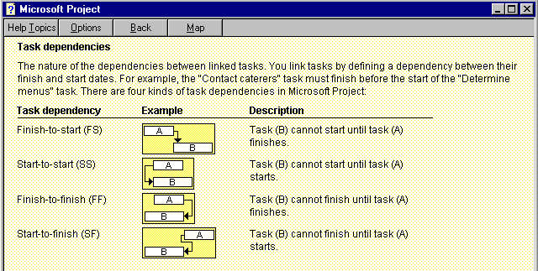
Task dependencies
Finish to Start: You cannot provide user training until after software has been installed.
Start to Start: A group of activities all start simultaneously.
Finish to Finish: Quality control efforts cannot finish before production finish
Start to Finish: An organization might strive to stock raw material just in time for the manufacturing process to begin. A delay in the manufacturing process starting should delay completion of stocking the raw material.
Notes:
Start to start : related to concurrent engineering

Slide 22
Activity 4
You are coordinating a software development project that includes two critical tasks: Task A involves writing the code for a new feature, and Task B involves creating the associated documentation that will be used by the end-users. You have decided that the documentation process should begin as soon as the coding starts because the documentation team can start outlining and preparing the basic structure and background sections while the developers are coding.
What is the relationship between A and B?
How is the scenario relevant to lead or lag?

Slide 23
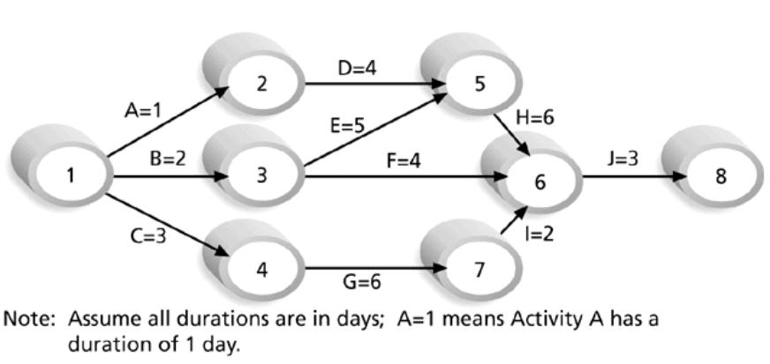
Showing Sequence
A network diagram is a display of activities and their sequences
Two methods
Arrow (AOA)
Precedence
diagramming (PDM)
AOA diagram

Slide 24
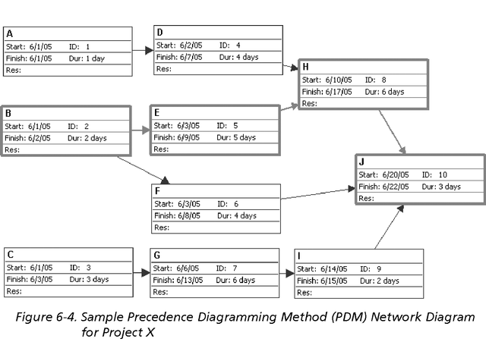
Showing Sequence (cont’d)
PDM diagram

Slide 25
Network Diagram points
Every activity on the network diagram must be completed in order for the project to finish.
Not every single item on the list need to be shown on the network diagram.
The precedence diagram method (PDM) is used more often than AOA as it provides various advantages.
Only finish to start can be represented on AOA.
We have to use dummy activities in AOA to show relationships.

Slide 26
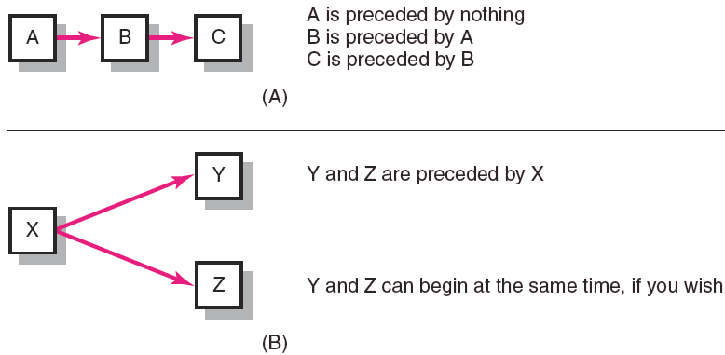
Precedence diagramming

Slide 27
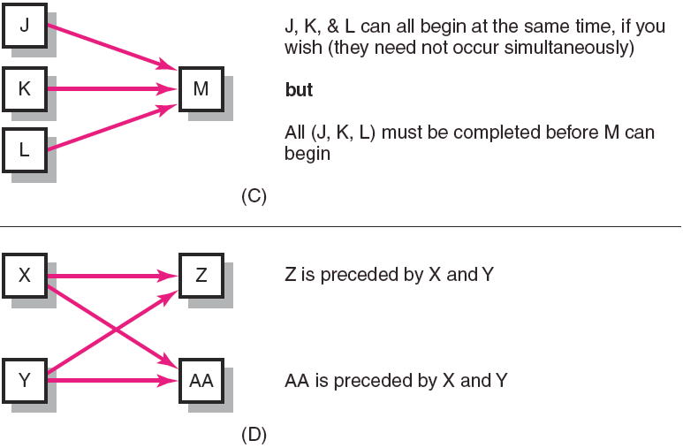
Precedence diagramming

Slide 28
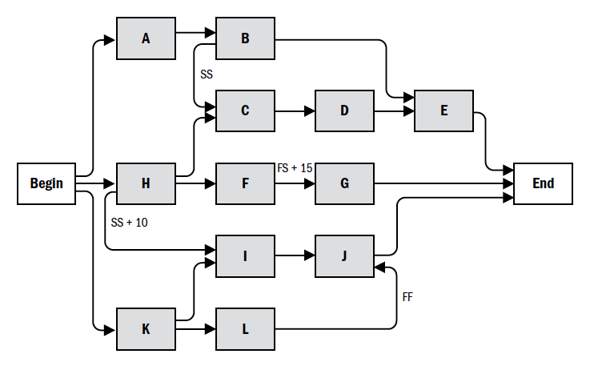
Precedence diagramming
Any type of dependencies, leads/lags can be presented through PDM

Slide 29
4. Determine duration -Resourcing (People / Equipment / Material)
You need to have
Good idea of the quantity and
Type of resources to be assigned to each activity
Consider the following
How difficult will it be to complete specific activities on this project?
What is the organization’s history in doing similar activities?
Are the required resources available?
Output
Resource Breakdown Structure: hierarchical structure that identifies the project’s resources by category and type.
Resource categories may include: analyst, developers, testers, project managers.
Notes:
fill in more information into the activity box
Resource estimation provides a basis ofr estimating activity duration. In addition, it is also releven to cost estimation (resource need cost), communication management and HR management.

Slide 30
4. Determine Duration
Duration includes
Actual amount of time worked on an activity
Elapsed time
Effort is the number of workdays or work hours required to complete a task
Effort does not normally equal duration
People doing the work should help create estimates, and an expert should review them
Use 3-point estimate in PERT (program Evaluation and Review Technique): optimistic, most likely, pessimistic estimate.

Slide 31
5. Develop Schedule
Previous projects are good references!
Determine the start and end dates of the project. Uses several iterations.
Always create a realistic schedule
The first tool for monitoring progress
Consequences of unrealistic schedule is BIG!
Many different tools
Network diagram
Gantt charts
Critical path analysis
Critical chain scheduling
PERT analysis

Slide 32
Gantt chart
Provides standard format of displaying project schedule information by listing project activities and their corresponding start and finish dates in calendar format
Activities on the Gantt Chart must coincide with the activity list and the milestone list
Gantt Chart contains milestones, summary tasks, individual task duration, and arrows showing task dependencies
You can create Milestones by creating a task (duration will be zero) and making it as milestone In MS Project

Slide 33
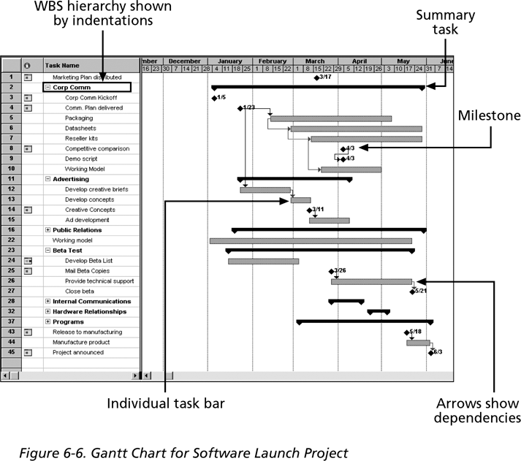
Gantt chart (cont’d)

Slide 34
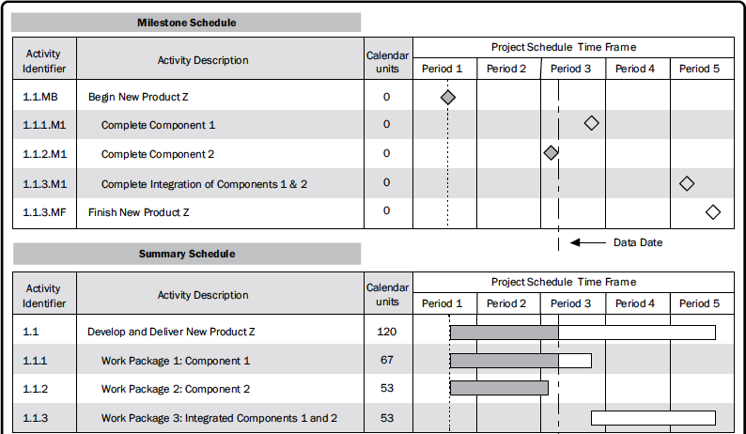
Milestone/summary schedule in Gantt chart

Slide 35
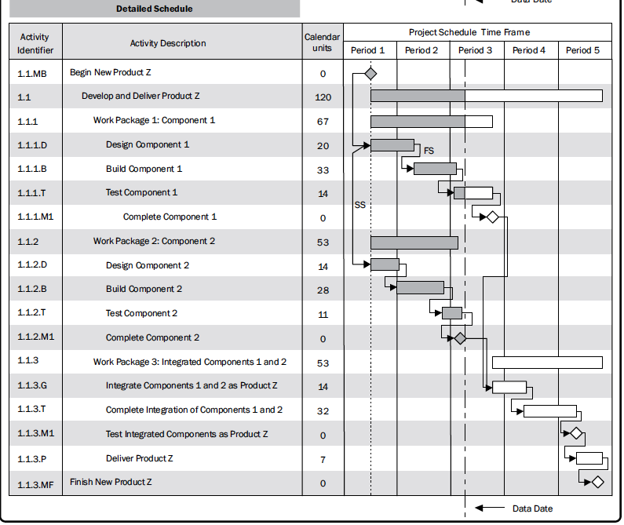
Detailed schedule in Gantt chart

Slide 36
Activity 5
Draw a precedence diagram based on the following description on activities.
Activity A: "Market Research"
Duration: 3 days
Dependencies: None
Activity B: "Product Design"
Duration: 5 days
Dependencies: Starts after Activity A is completed
Activity C: "Prototype Creation"
Duration: 4 days
Dependencies: Can start 2 days before Activity B is completed (Lead: 2 days)
Activity D: "Product Testing"
Duration: 6 days
Dependencies: Cannot start until the Prototype Creation (Activity C) is completed
Activity E: "Marketing Plan Development"
Duration: 4 days
Dependencies: Starts 1 day after Market Research (Activity A) is completed (Lag: 1 day)
Activity F: "Production Planning"
Duration: 3 days
Dependencies: Can only start after both Product Design (Activity B) and Product Testing (Activity D) are completed

Slide 37
Network diagram compared to Gannt
Network diagram is more technical, helps determine the critical path
Network diagram is not to a scaled timeline
Gantt is easy to read and explain to on-technical people
Gannt is a good method for graphically illustrating task progress and whether things are ahead of schedule or behind

Slide 38
Preliminaries of critical path
Technique to predict total project duration
A critical path is series of activities that determines the earliest project completion time
Is the longest path in a network diagram
Has the least amount of slack or float
Slack (or float) is the amount of time an activity can be delayed without delaying
a succeeding activity
the project finish date

Slide 39
Summary
Schedule management
Plan
Define activities
Sequence activities
Estimate duration
Develop schedule
Illustrate schedule (network diagram, Gantt chart)

Slide 40
What’s next
More on techniques for project scheduling/monitoring/controlling - critical path analysis, PERT analysis

